Slide 1
Supercomputing Centre
Face Detection
Text Recognition
Image Captioning
Subject Recognition
Landmark Recognition
Image Files
Image Processors
Object Store
ML Classifier
Upload to Pawsey
Storage Interface
CSV
XML
JSON
Library
Flat File Writer
Output Flat File
Input MARC
MARC Reader
Relational Database
Library
MARC Writer
Output MARC
MARC
XML
JSON
Geocoding
Date Detection
Link Resolution
Metadata Parsers
MARC
XML
JSON
Notes:
Overall architecture

Slide 2
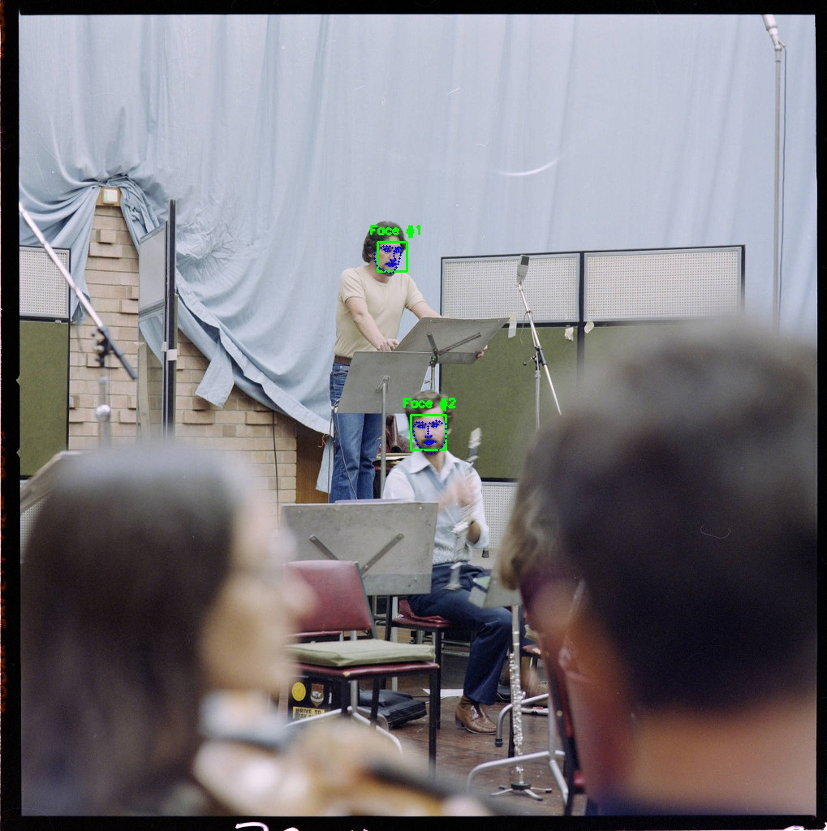
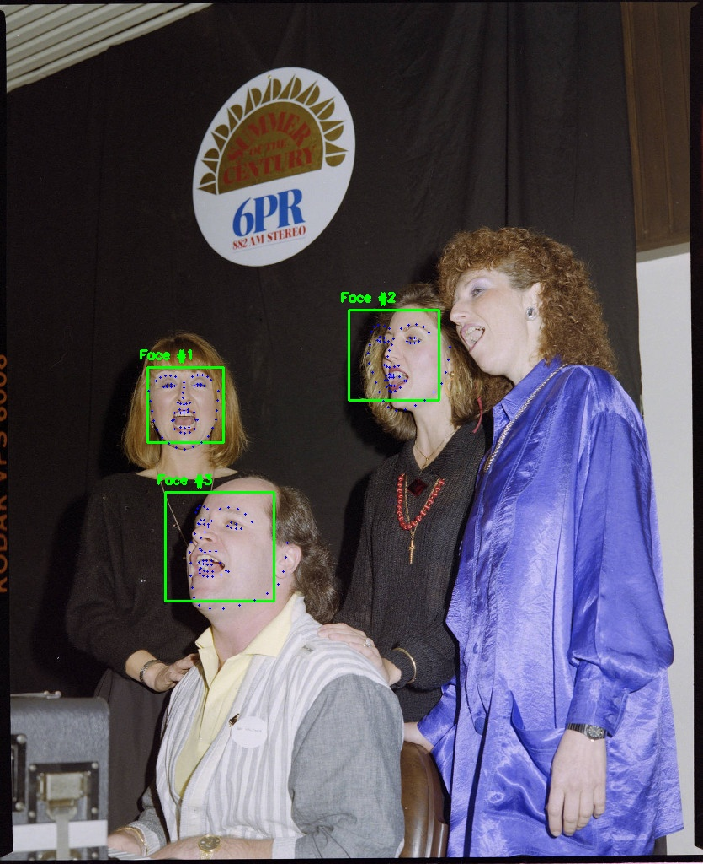
L: Detects principle subjects (at some distance)
R: Misses one principle subject because face is at too extreme an angle
Notes:
Convert Metadata format

Slide 3
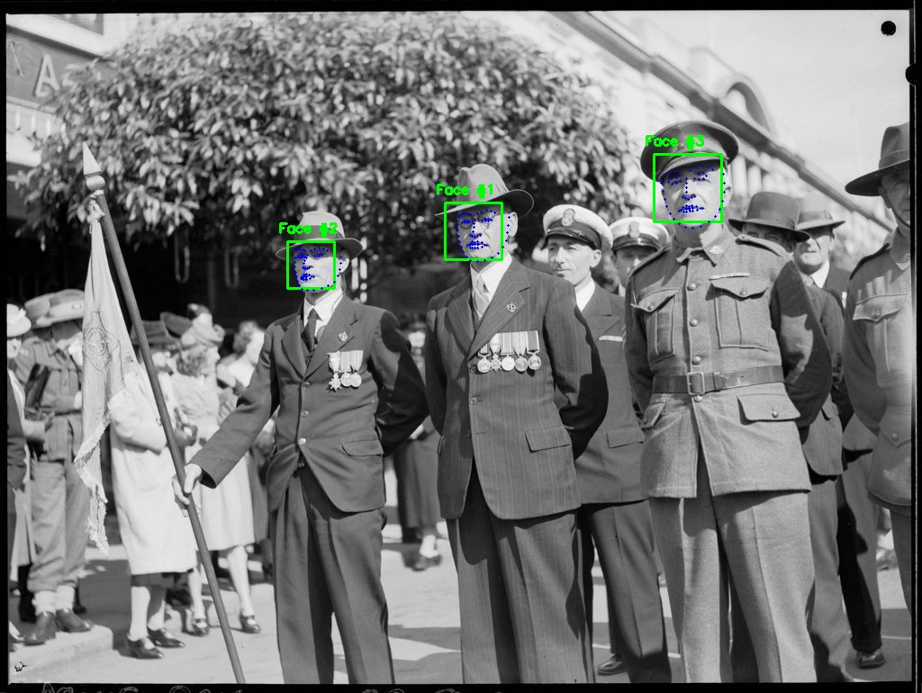
Detects principle subjects
Notes:
Face detection

Slide 4
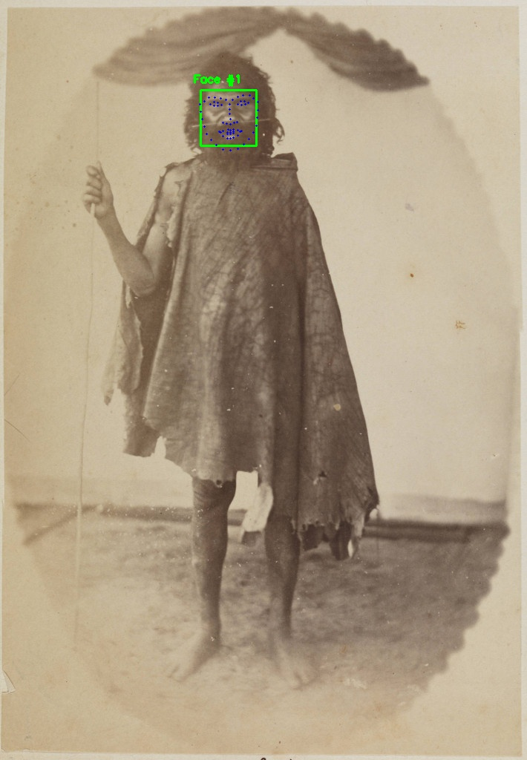
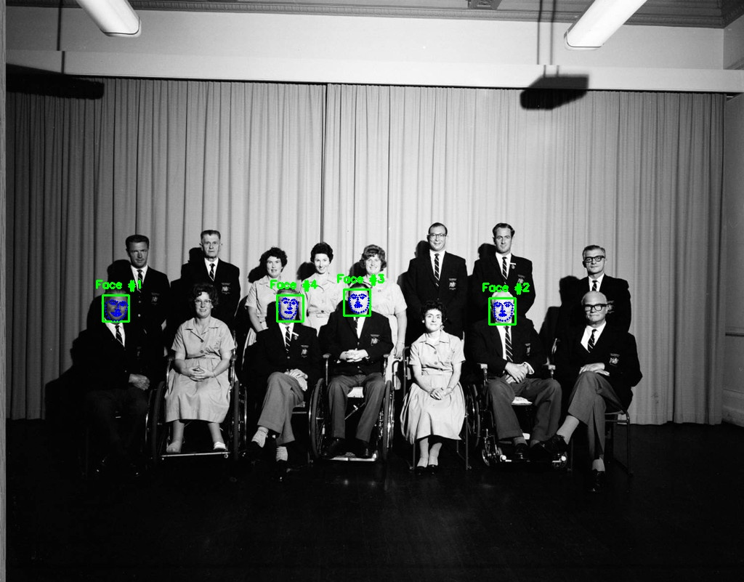
L: Detects face from old photo
R: Misses some faces because they are too small – will be addressed with larger images
Notes:
Face detection

Slide 5
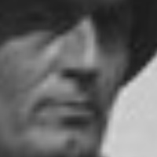
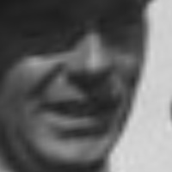
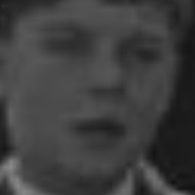
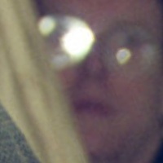


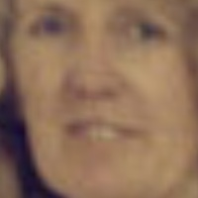




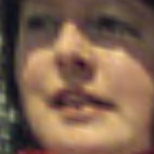

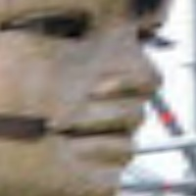

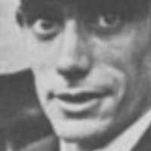
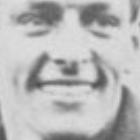

Photo distortion is caused by normalisation – all eyes and lips are moved to the same place.

Slide 6
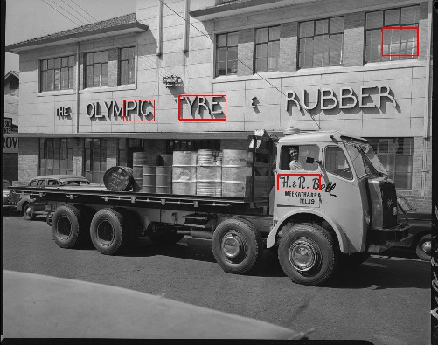
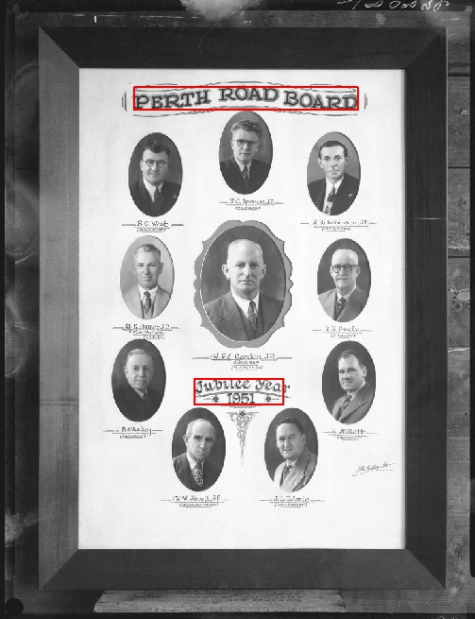
L: Has difficulty detecting low contrast text
R: Detects main headings, individual names are too small

Slide 7
Mappify API
2,500 request limit per day (free)
Based on PSMA G-NAF dataset
Image Title
Parsed Address
Geocoded Address
311688PD: Durham House building premises of Wrightson Dance Studios, The Inn Trim hairdressers, Galore House (no. 842) and Marjorie Young Antiques (no. 836) Hay Street, Perth, December 1982
building_name: None
street_number: ‘836-842’
street_name: 'Hay’
street_type: 'Street'
suburb: 'Perth’
state: 'WA'
location_type: ‘parsed’
building_name: None
street_number: '838-842’
street_name: 'Hay’
street_type: 'Street'
suburb: 'Perth’
post_code: '6000’
state: 'WA'
longitude: 115.85448
latitude: -31.95236,
confidence: 0.05,
location_type: 'geocoded’

